Slide 1


Kubernetes
Architecture
Brought to you by

Slide 2
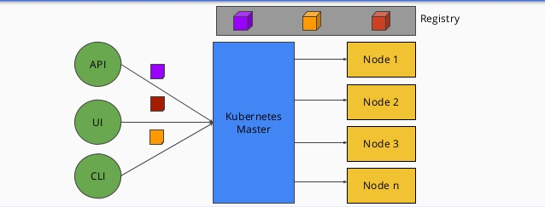
Kubernetes Architecture Simplified

Slide 3
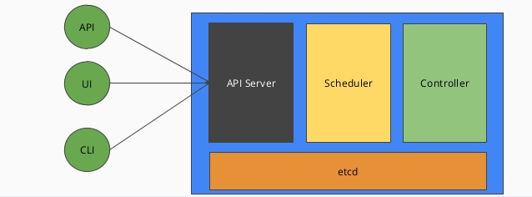
Kubernetes Master

Slide 4
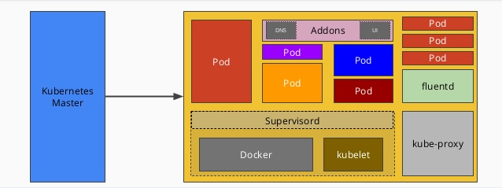
Kubernetes Node

Slide 5
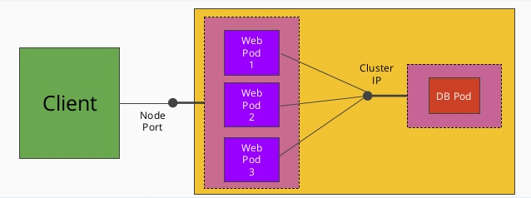
Kubernetes Services

